Slide 1

TESLA STOCK ANALYSIS
Yamini Manral

Slide 2
Introduction
Analyzing Tesla's stock using machine learning can involve the development of predictive models that aim to forecast price movements, identify optimal entry and exit points, and assess risk factors. Additionally, sentiment analysis of news articles, social media, and market reports can provide valuable information on public perception and potential market sentiment shifts.
In this era of big data, machine learning equips investors with advanced tools to navigate the dynamic landscape of financial markets. The integration of predictive modeling, natural language processing, and data-driven analytics can contribute to a more comprehensive understanding of Tesla's stock behavior, offering investors a competitive edge in decision-making.

Slide 3
Objectives
Utilize historical stock price and relevant financial data to build machine learning models that can predict future stock prices.
Develop models to analyze and predict the volatility of Tesla stock. Understanding stock volatility can be valuable for risk management and investment strategy.
Build anomaly detection models to identify unusual patterns or outliers in Tesla stock data. This can be useful for detecting potential irregularities or market disruptions.
Compare Tesla's stock performance with that of its competitors in the automotive and technology sectors. Machine learning models can help identify patterns and trends that differentiate Tesla from its peers, providing a comprehensive view of its competitive position in the market.
Develop models to predict the long-term performance of Tesla stock, considering factors such as industry trends, technological advancements, and global economic conditions.

Slide 4
About
Tesla stock has been known for its high volatility, with significant price fluctuations over time. The stock's performance has been influenced by factors such as production numbers, delivery figures, financial results, and market sentiment.
Tesla has experienced substantial growth in market capitalization, becoming one of the most valuable automakers globally. The company's ambitious plans for electric vehicles (EVs) and renewable energy have contributed to its perceived long-term potential.
Tesla's financial performance has varied, with periods of losses and profits. Investors closely monitor the company's earnings reports, production numbers, and gross margins to assess its financial health and sustainability.
Tesla is often associated with innovation in electric vehicle technology and autonomous driving. Announcements about new products, advancements in battery technology, and updates on the development of self-driving capabilities have impacted the stock's performance.

Slide 5
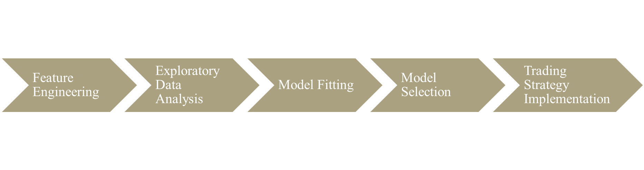
Methodologies

Slide 6
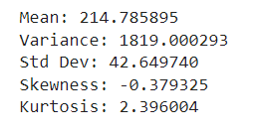
Mean, Variance, Standard Deviation, Skewness and Kurtosis
Mean: Represents the central tendency of a dataset.
Variance: Measures the spread of data points from the mean.
Standard Deviation: Indicates the average deviation of data points from the mean.
Skewness: Measures the asymmetry of a distribution.
Kurtosis: Measures the tailedness of a distribution.

Slide 7
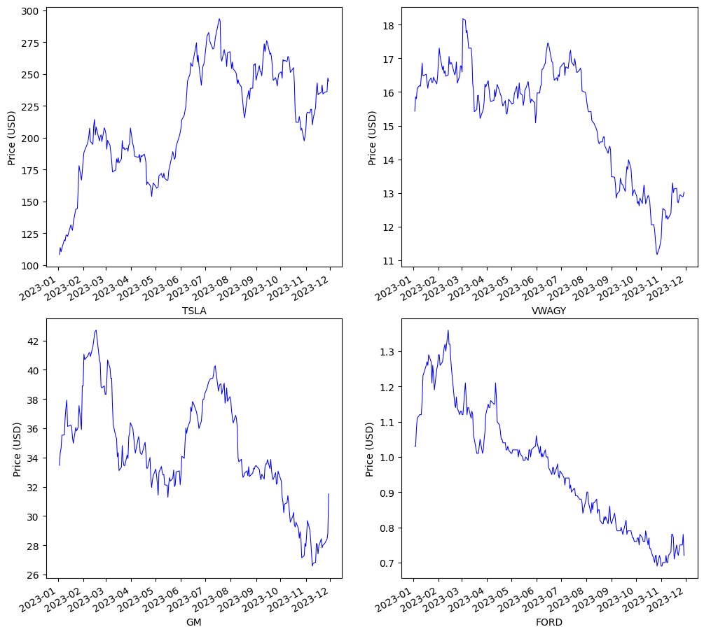
Stock Comparison
Tesla
Volkswagen
General Motors
Ford

Slide 8
Kernel Density
The bandwidth parameter in KDE controls the amount of smoothing applied to the data. A smaller bandwidth results in a more sensitive estimate, closely following the data points, while a larger bandwidth produces a smoother estimate.
KDE allows for the comparison of multiple distributions. By overlaying KDE plots for different datasets or subsets, analysts can visually compare the shapes and characteristics of the distributions.
The area under the KDE curve over a specific range corresponds to the probability of observing data within that range. This property makes KDE a valuable tool for calculating probabilities and understanding the likelihood of certain events within the dataset.

Slide 9
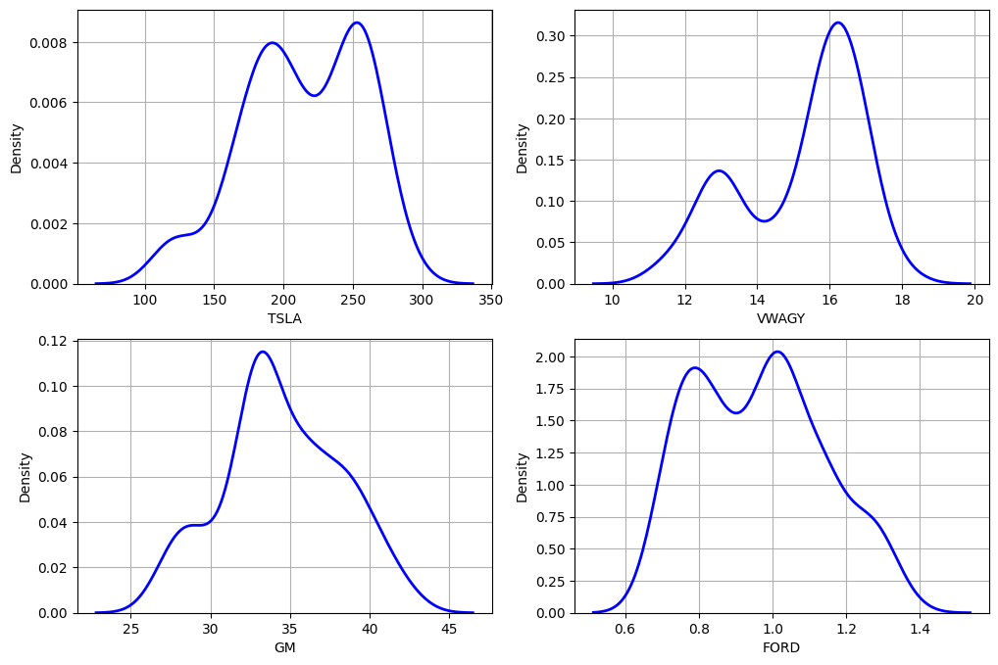
Kernel density plot

Slide 10
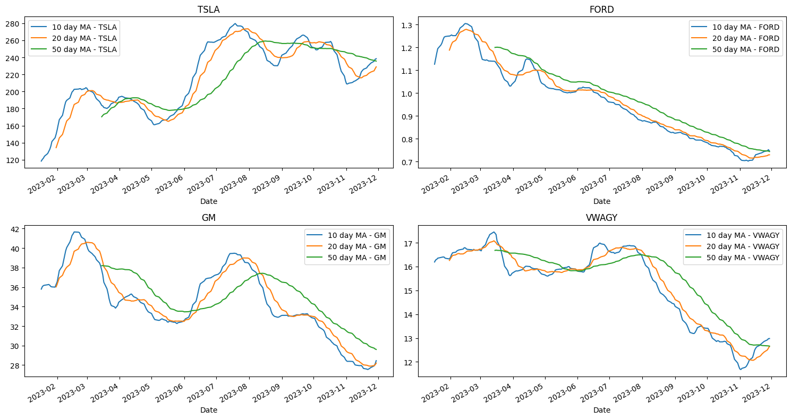
MOVING AVERAGE FOR ALL COMPETITORS

Slide 11
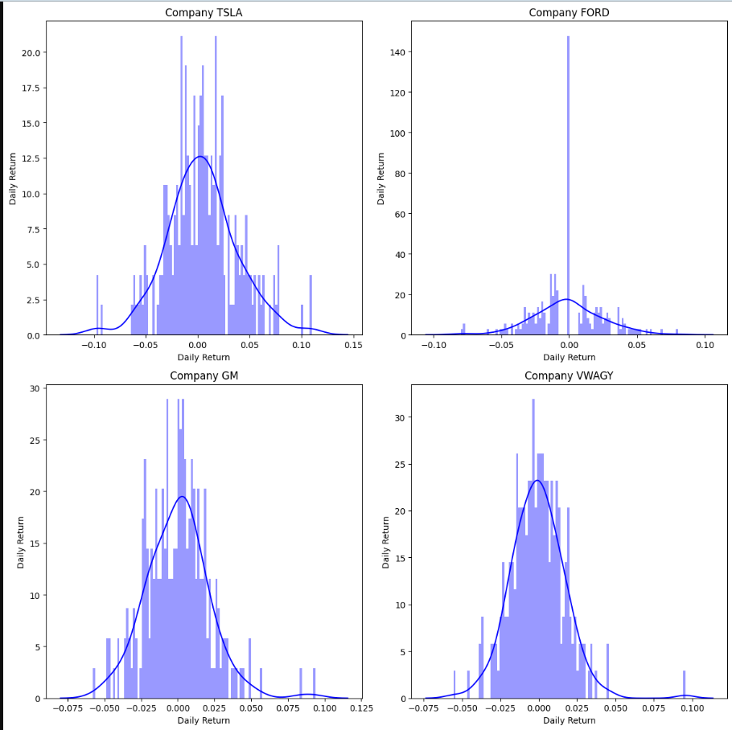
Calculating daily returns

Slide 12
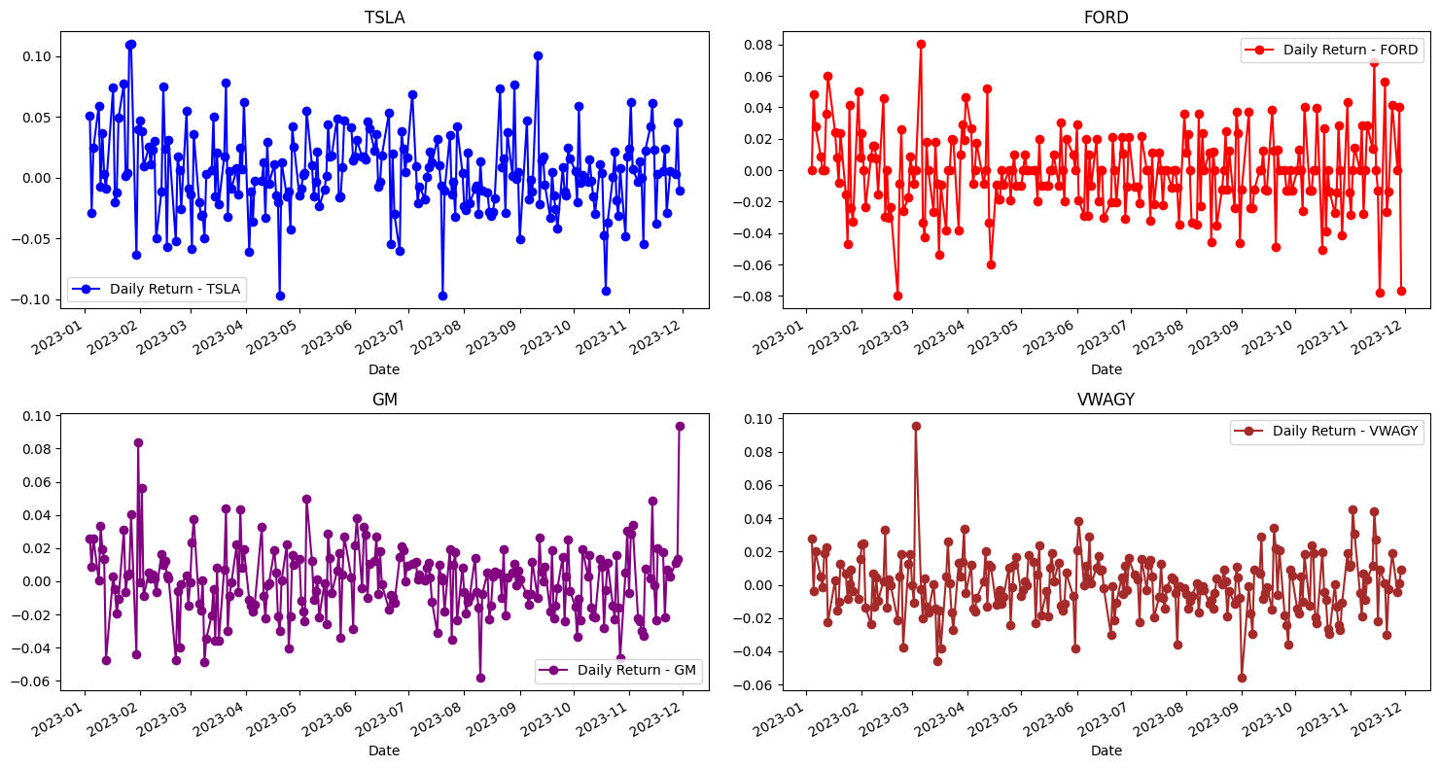
Percentage change – Daily Returns

Slide 13
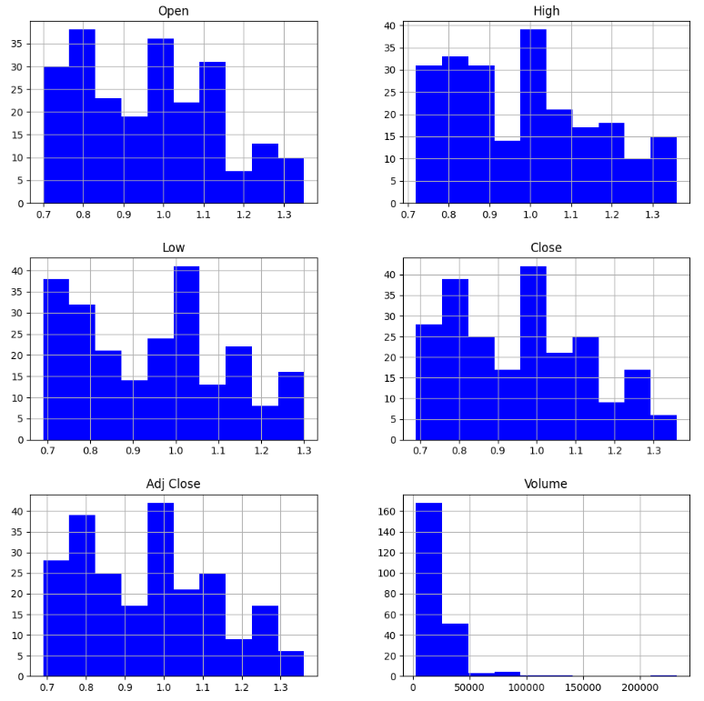
Histogram - FORD

Slide 14
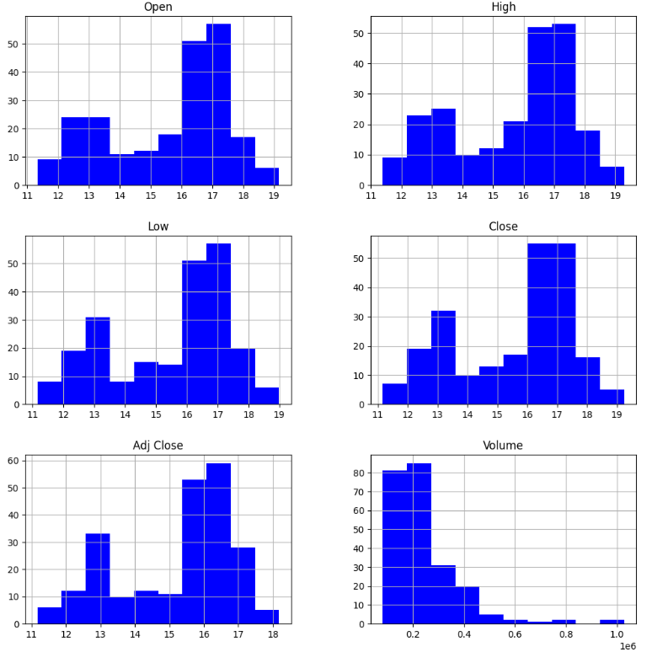
Histogram - VWAGY

Slide 15
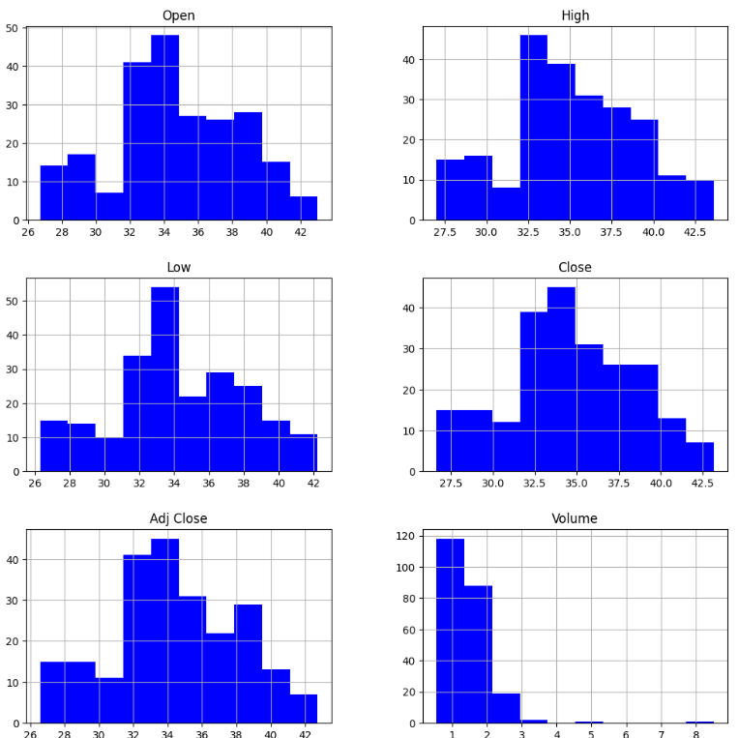
Histogram - GM

Slide 16
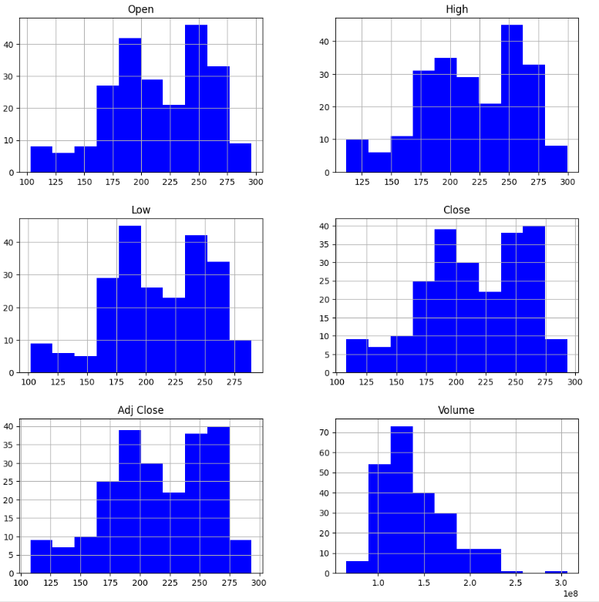
Histogram - TSLA

Slide 17
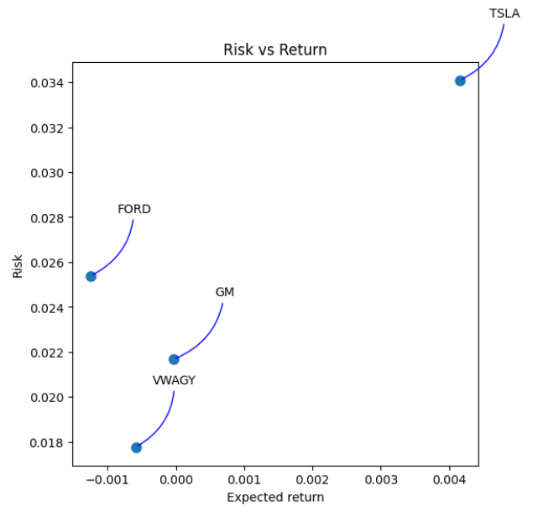
Risk vs Returns

Slide 18
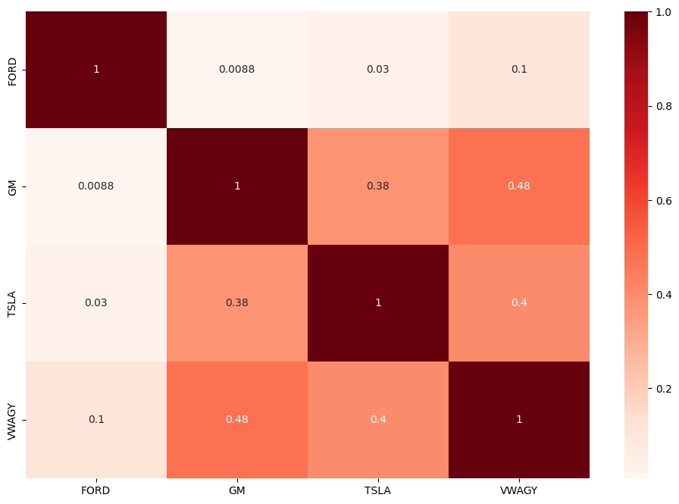
Correlation between returns of all competitors

Slide 19

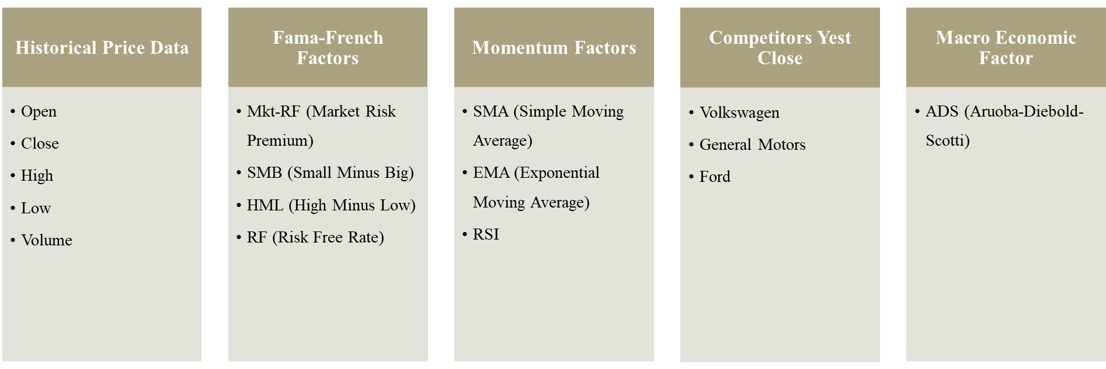
FEATURE ENGINEERING
Y Close Price
X

Slide 20
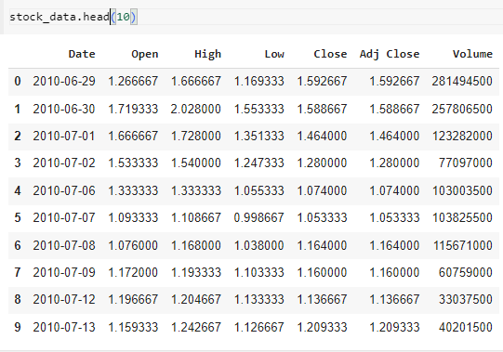
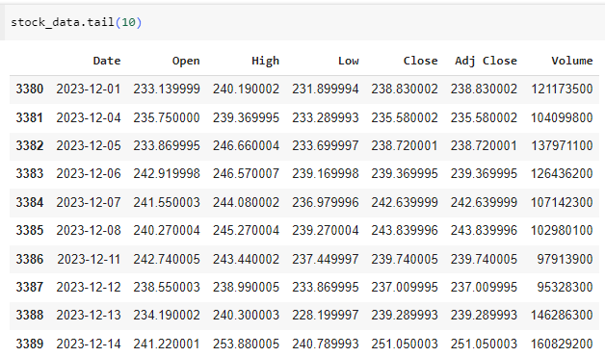
stock_data

Slide 21
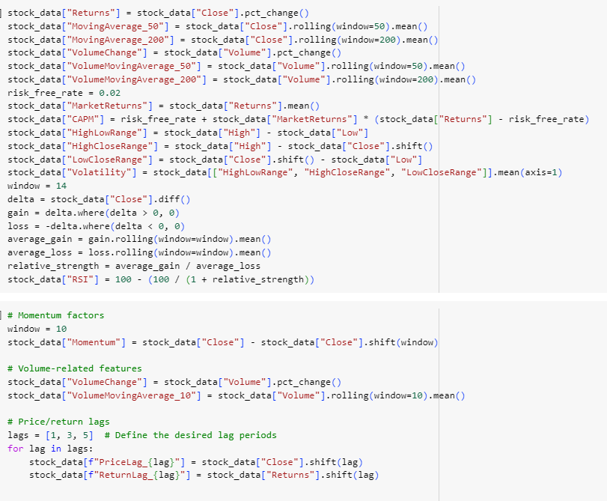
Generating Momentum Factors with stock_data

Slide 22
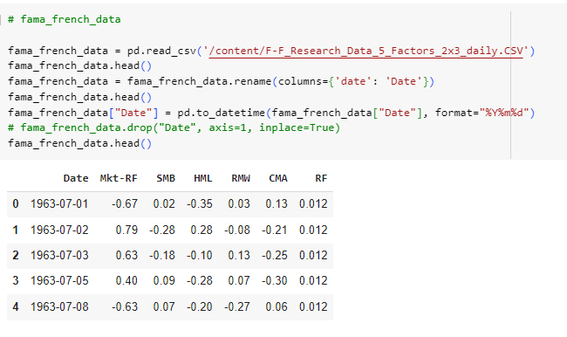
Fama/French 5 Factors (2x3) [Daily]

Slide 23
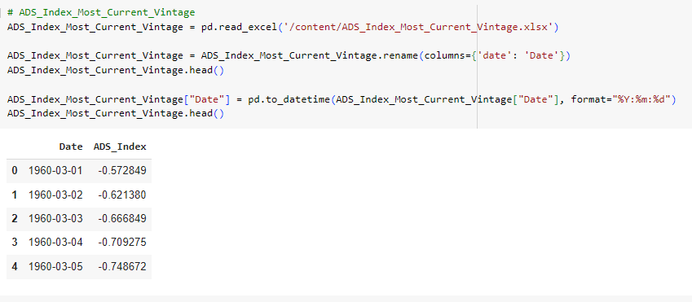
ADS Index Most Current Vintage

Slide 24
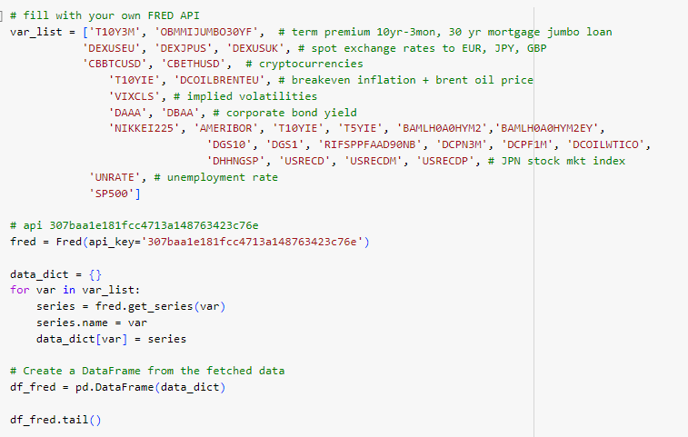
FRED - Federal Reserve Economic Data

Slide 25
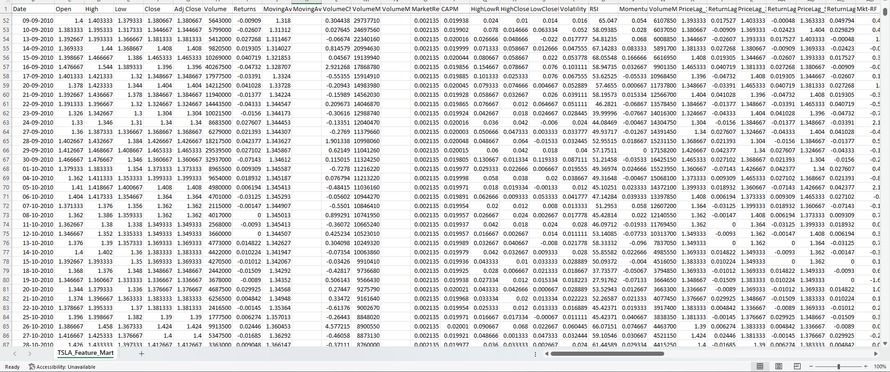
Resulting Feature Mart

Slide 26
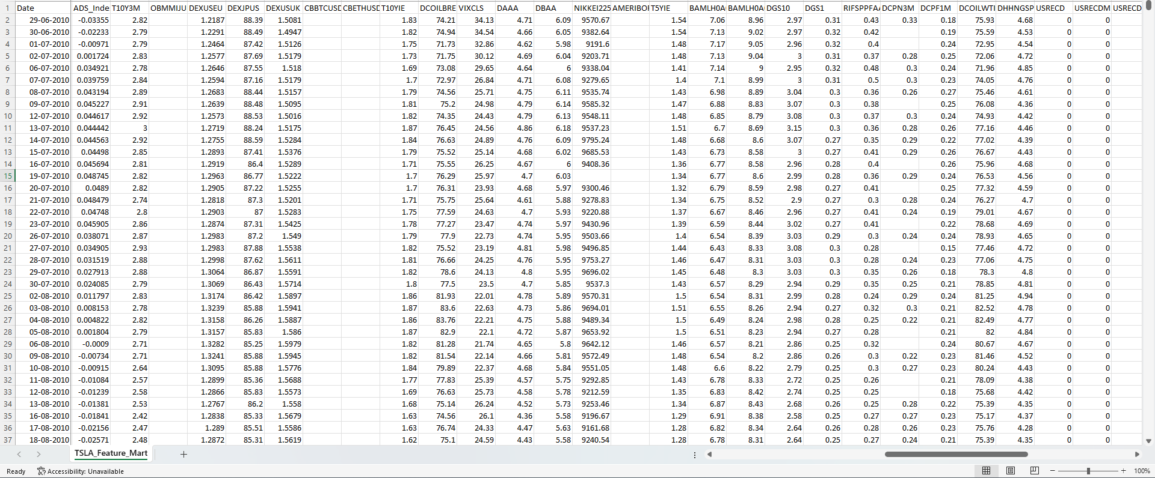

Slide 27
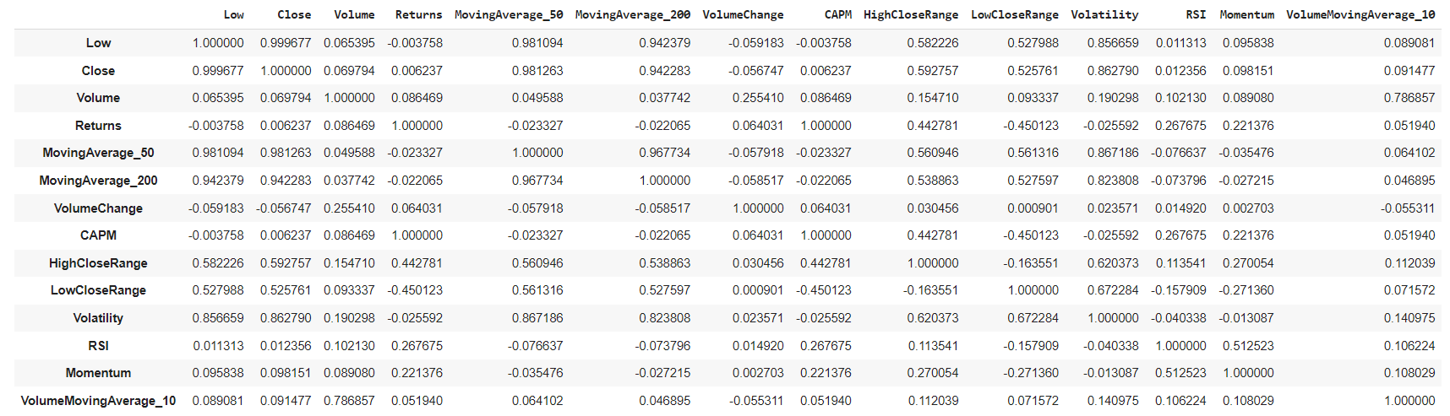
Correlation Matrix of the features of TSLA

Slide 28
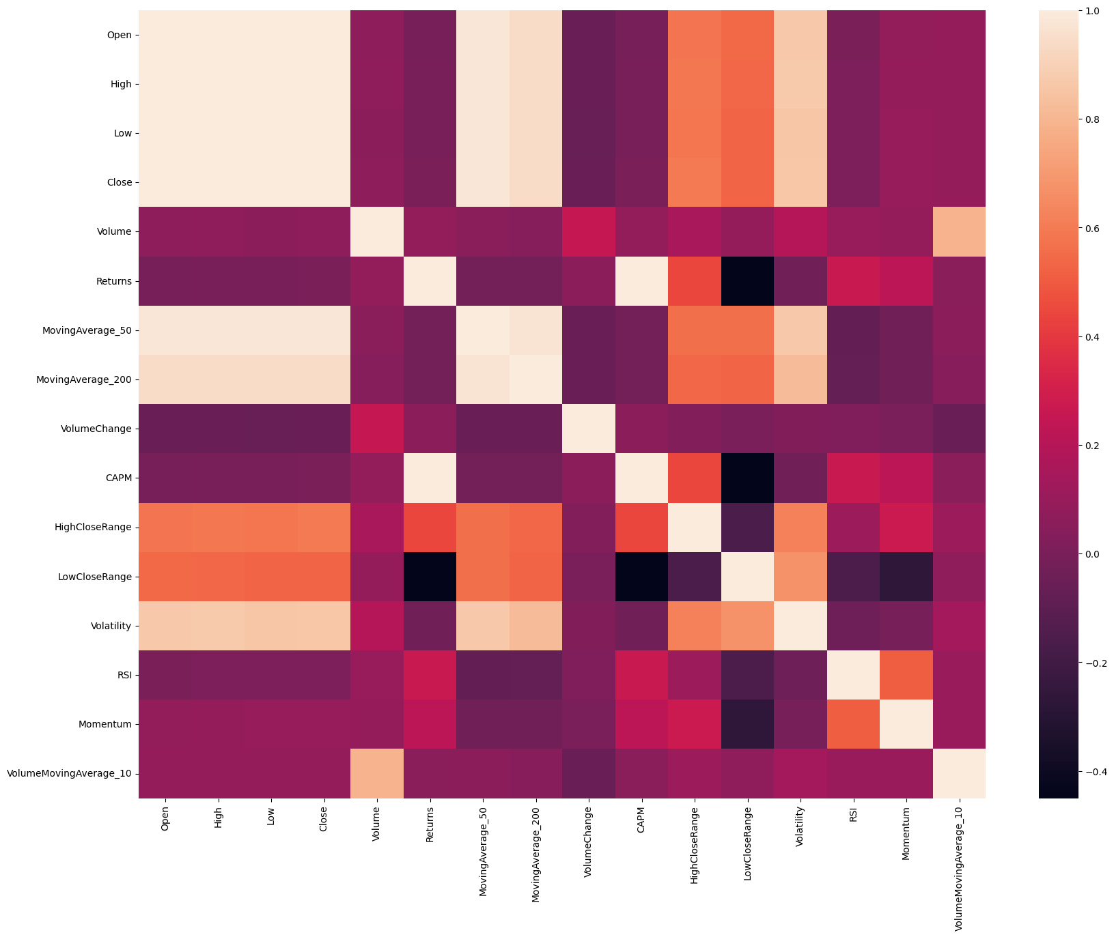
Correlation Matrix of the features of TSLA

Slide 29
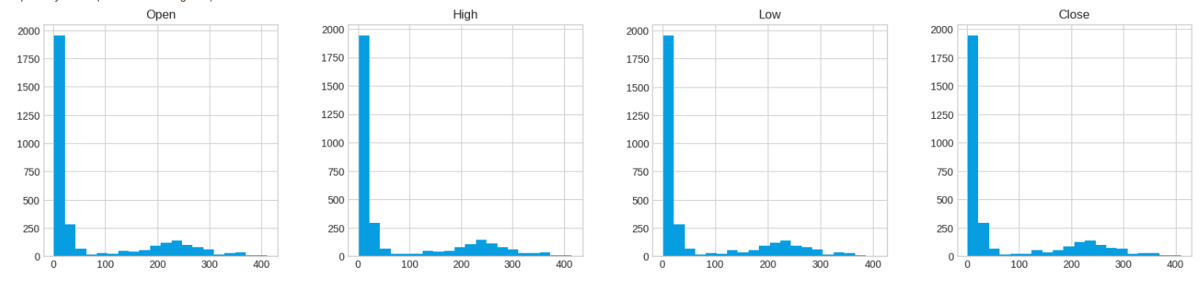
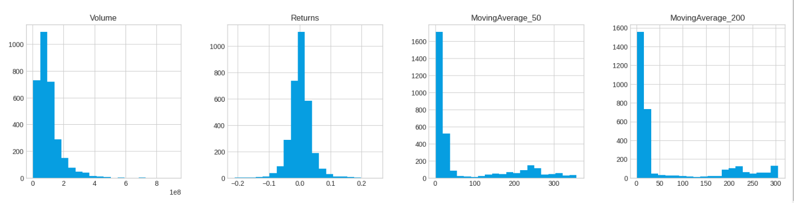

Slide 30
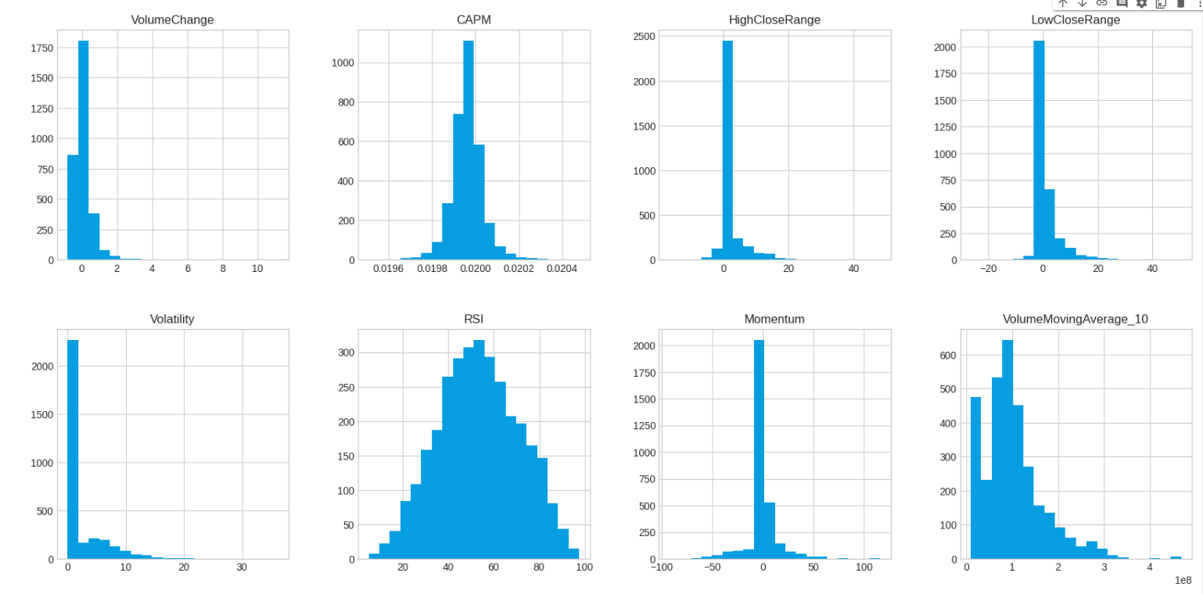

Slide 31
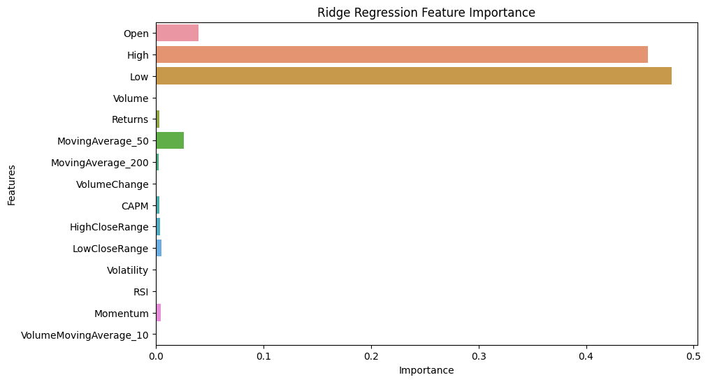
Feature Importance Ridge Regression

Slide 32
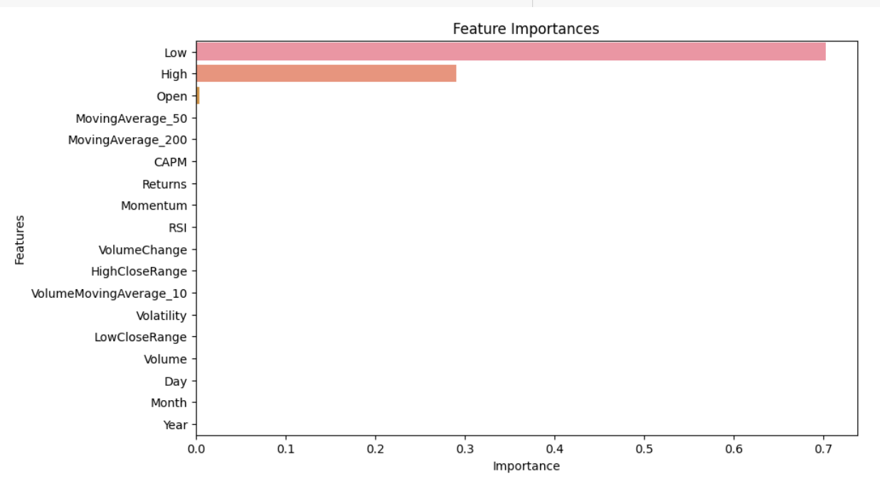
Feature Importance Random Forest Regression

Slide 33
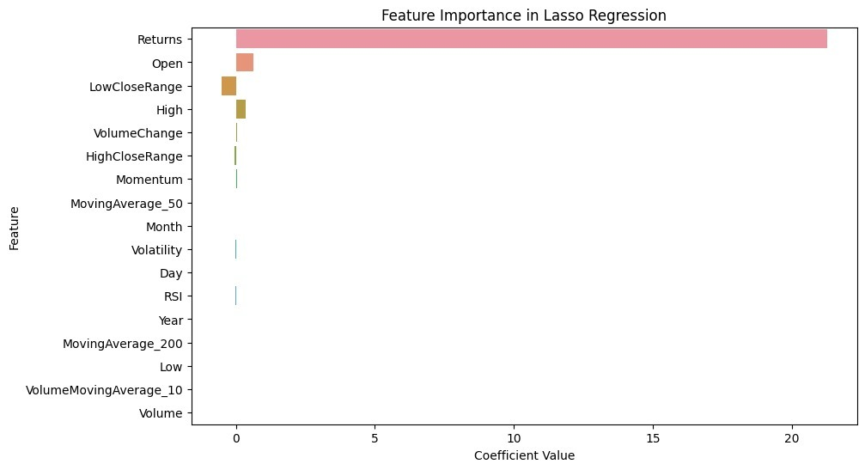
Feature Importance LASSO Regression

Slide 34
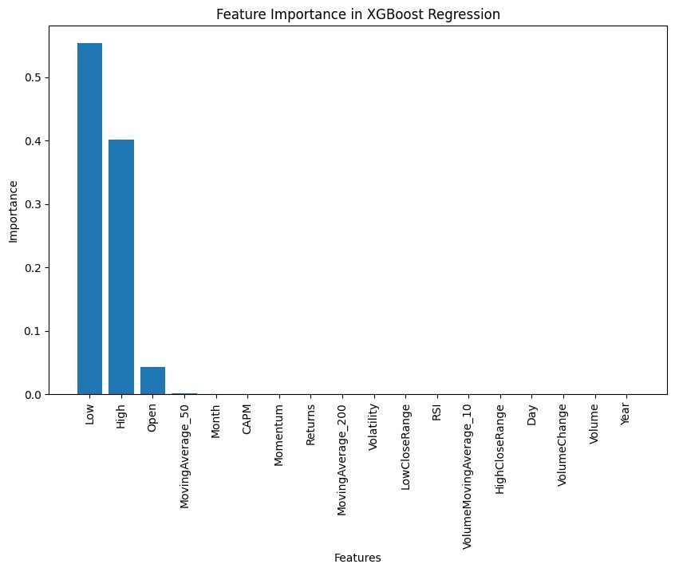
Feature Importance XGB Regression

Slide 35
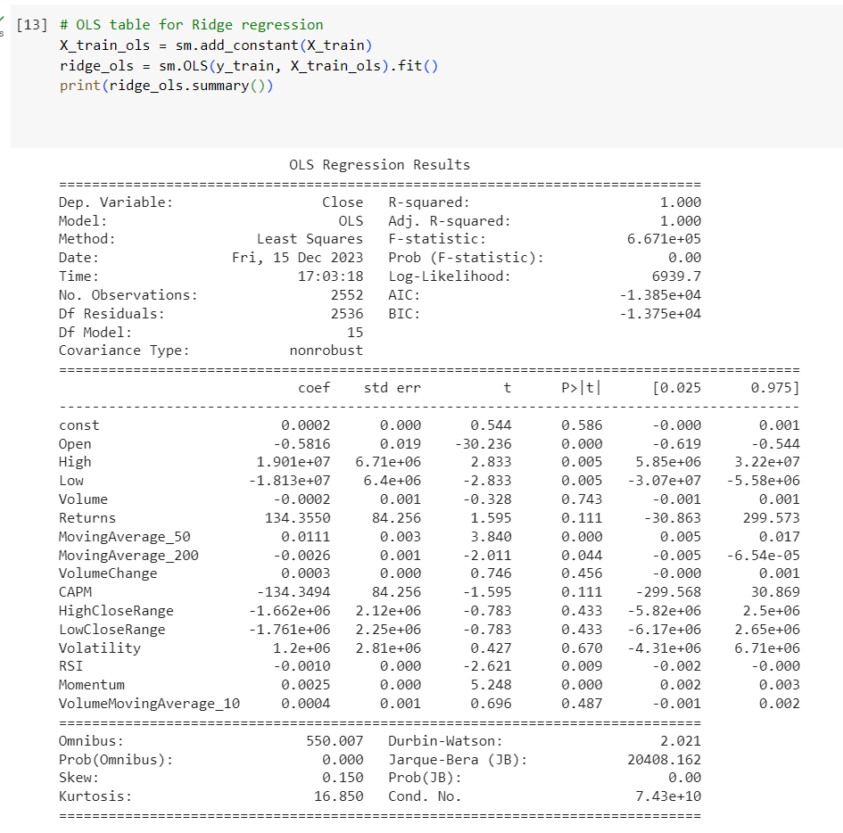
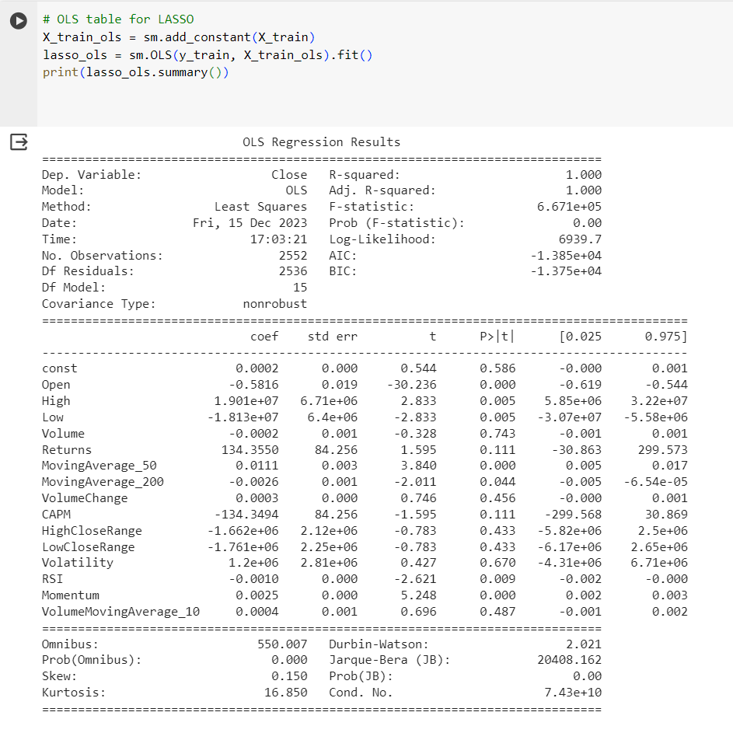
OLS TABLE

Slide 36

MODEL TRAINING

Slide 37
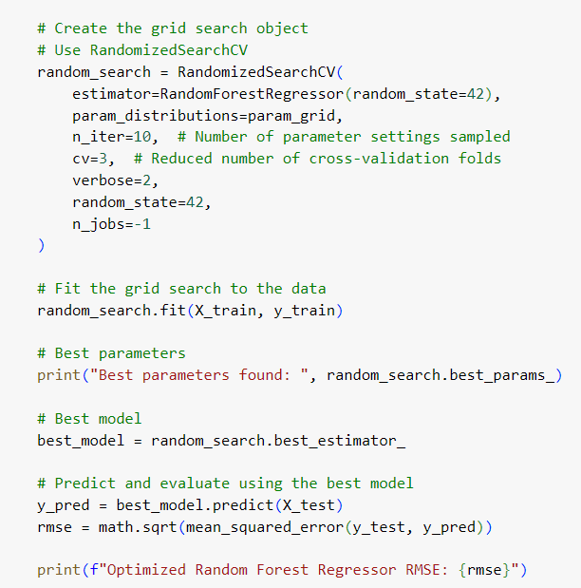
Random Forest Regressor
The code starts by loading a dataset (TSLA_Feature_Mart_IMP.csv) and performing basic preprocessing steps. It converts the 'Date' column to datetime, extracts year, month, and day as separate features, and drops the original 'Date' column. The target variable (y) is defined as the 'Close' column, and the feature matrix (X) is constructed by excluding the 'Close' column.
The data is split into training and testing sets using train_test_split. 80% of the data is used for training (X_train, y_train), and 20% is reserved for testing (X_test, y_test).
A RandomizedSearchCV object is created to perform hyperparameter tuning for a Random Forest Regressor. The hyperparameters considered include the number of estimators, maximum depth of trees, minimum samples required to split an internal node, and minimum samples required at a leaf node. The search is configured to randomly sample 10 combinations from the specified parameter space, using 3-fold cross-validation.
The RandomizedSearchCV object is fitted to the training data, searching for the best hyperparameters. The best hyperparameters and the corresponding best model are printed. The best model is then used to make predictions on the test data (X_test), and the root mean squared error (RMSE) is calculated to evaluate the model's performance.

Slide 38
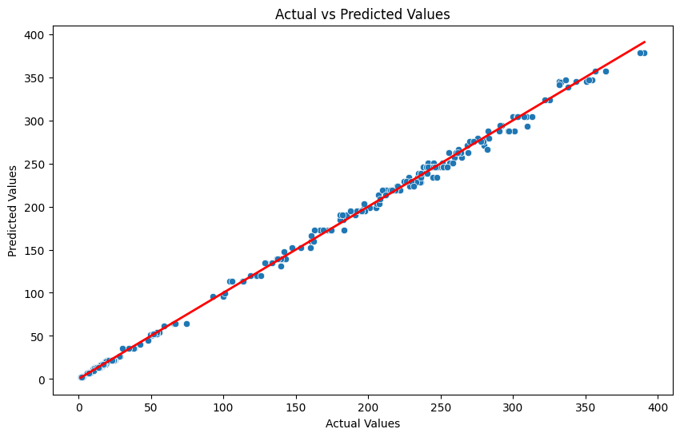

Slide 39
Ridge Regression
Ridge regression, a linear regression variant with L2 regularization, to model the relationship between the features (X_train) and the target variable (y_train). Ridge introduces a penalty term (controlled by the hyperparameter alpha) to prevent overfitting.
A grid search is performed to find the optimal value for the hyperparameter alpha. The range of alpha values to explore is defined using np.logspace(-4, 4, 20), which spans a range of values from 0.0001 to 10000 in a logarithmic scale. The grid search uses 5-fold cross-validation and employs the negative mean squared error as the scoring metric.
The best alpha value for Ridge is identified from the grid search results (best_alpha). A new Ridge model (best_ridge_model) is then created with the optimal alpha and trained on the training data (X_train, y_train).
The trained Ridge model is used to make predictions (y_pred_best_ridge) on the test data (X_test). These predictions can be evaluated to assess the model's performance on unseen data.

Slide 40
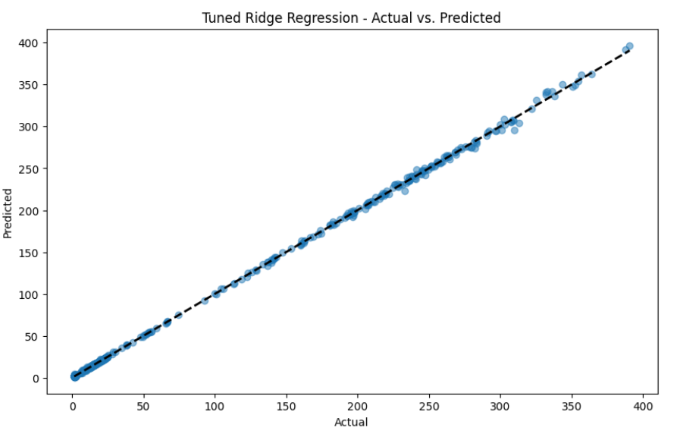
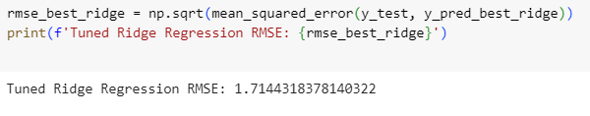
Ridge Regression

Slide 41
LASSO (Least Absolute Shrinkage and Selection Operator) Regression
Lasso regression, a linear regression variant with L1 regularization, to model the relationship between the features (X_train) and the target variable (y_train). Lasso introduces a penalty term (controlled by the hyperparameter alpha) to encourage sparsity in the coefficient estimates
A grid search is performed to find the optimal value for the hyperparameter alpha. The range of alpha values to explore is defined using np.logspace(-4, 4, 20), which spans a range of values from 0.0001 to 10000 in a logarithmic scale. The grid search uses 5-fold cross-validation and employs the negative mean squared error as the scoring metric.
The best alpha value for Lasso is identified from the grid search results (best_alpha_lasso). A new Lasso model (best_lasso_model) is then created with the optimal alpha and trained on the training data (X_train, y_train).
The trained Lasso model is used to make predictions (y_pred_best_lasso) on the test data (X_test). These predictions can be evaluated to assess the model's performance on unseen data.

Slide 42
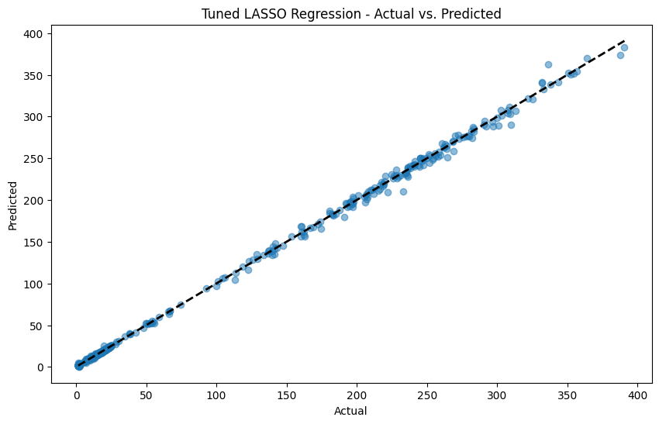
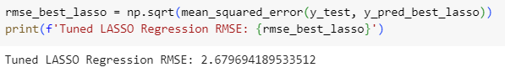
Tuned Lasso Regression

Slide 43
Extreme Gradient Boosting (XGBoost) Regressors
A RandomizedSearchCV object is created with the XGBoost regressor as the estimator. The search space for hyperparameters is defined, specifying potential values for each hyperparameter. The search is configured to randomly sample 10 combinations from this space and perform 3-fold cross-validation.
The RandomizedSearchCV object is fitted to the training data (X_train and y_train). This involves training and evaluating XGBoost models with different hyperparameter combinations to find the set of hyperparameters that yields the best performance based on cross-validation scores.
The best hyperparameters found by the randomized search are printed. Additionally, the best XGBoost model (with the optimal hyperparameters) is stored in the variable best_xgb_model. This model can then be used for making predictions on new data.

Slide 44
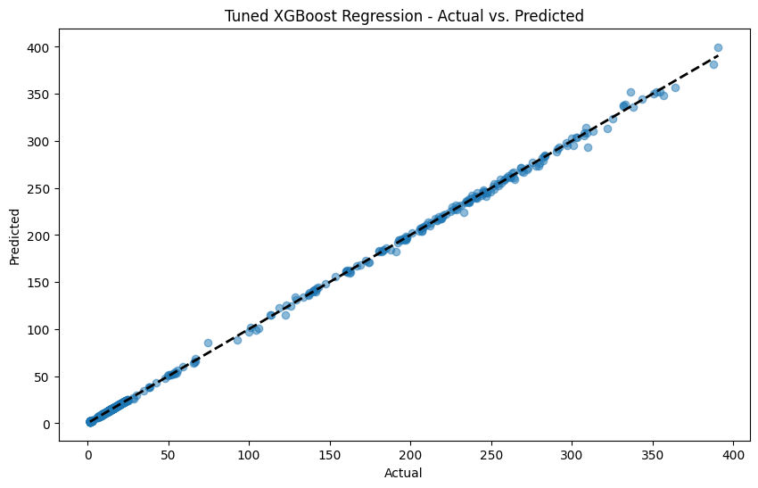
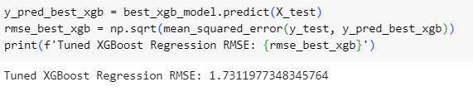
XGBoost Regressors

Slide 45
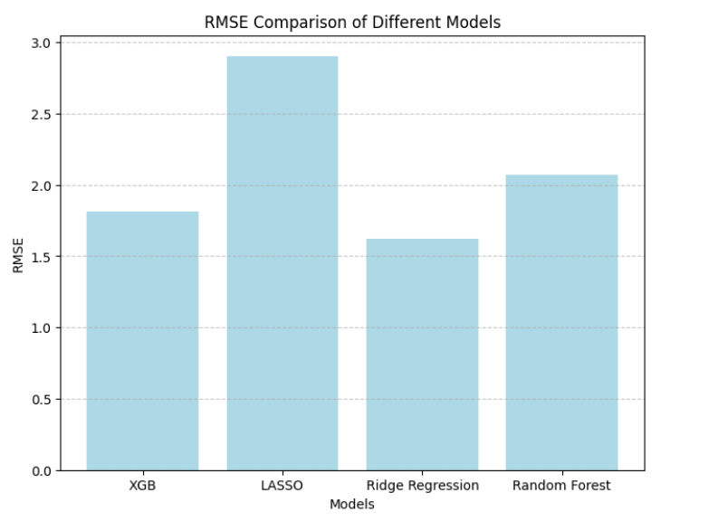
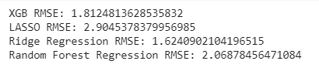
RMSE Comparison of different models

Slide 46
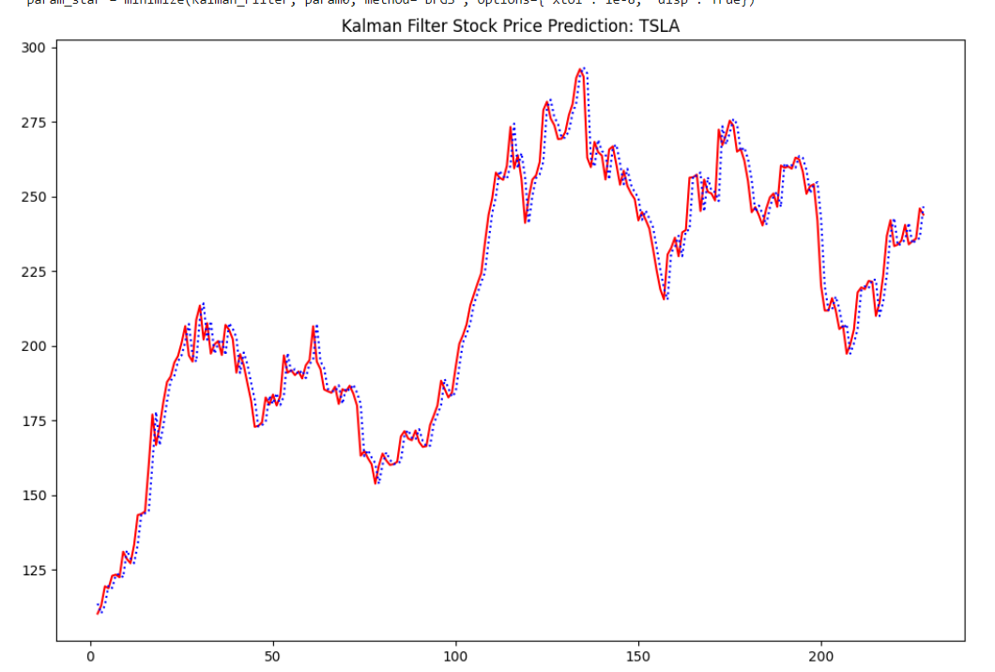
Kalman filter
Tesla's stock data from a specified date range and extracts the adjusted closing prices.
It initializes parameters for the Kalman Filter and optimizes them to minimize the output of the Kalman_Filter function.
The optimized parameters are then used in the Kalman_Smoother function to generate smoothed estimates of the stock price.
Plotting the original and smoothed stock prices, and calculates the root mean square error (RMSE) between the original and smoothed prices.

Slide 47
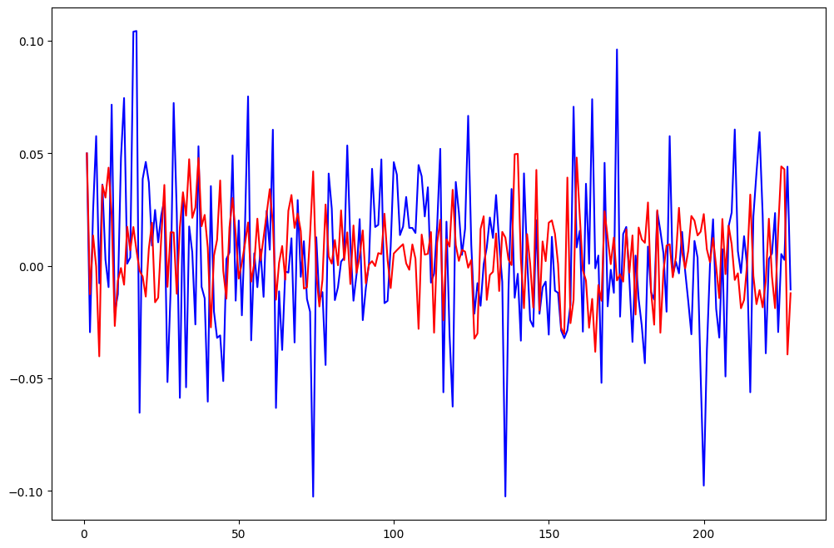
GARCH
The model provide a framework for capturing and modeling the time-varying volatility observed in financial time series data, making them valuable tools for risk management and financial analysis.

